Slide 1

Michigan Real Estate Price Predictor Models
Justin Clawson
Joel Fisher
Cole O’Neill
Selena Passeno
Zac Williams

Slide 2

PROJECT OVERVIEW
PROJECT DESCRIPTION
We used housing market data to try to predict the sale price of houses in Michigan based on factors like square footage, location, bedrooms and bathrooms, lot size, and zip code.
DATA SOURCE
Downloaded from Kaggle
USA Real Estate Dataset
Realtor.com
ETL PROCESS
Downloaded data, cleaned to include Michigan only
Drop duplicates and unneeded fields
Loaded to Spark SQL database

Slide 3








Tools Used

Slide 4
THE CLEANED DATA
How much data are we working with?
Original data = 1,084,909 rows, 12 columns
Cleaned (MI only) data = 22,076 rows, 11 columns
Removed previously sold date, duplicates, used only sold for models
Fun facts
404 square miles worth of property up for sale in Michigan!
ZIP with highest avg price is 49115 at $2.6M – along 94 just north of IN border
Just over $7B in real estate total
Other tidbits
Average house size 1,880 sq. ft., median 1,584.
Average price about $318,000, median price $210,000.

Slide 5
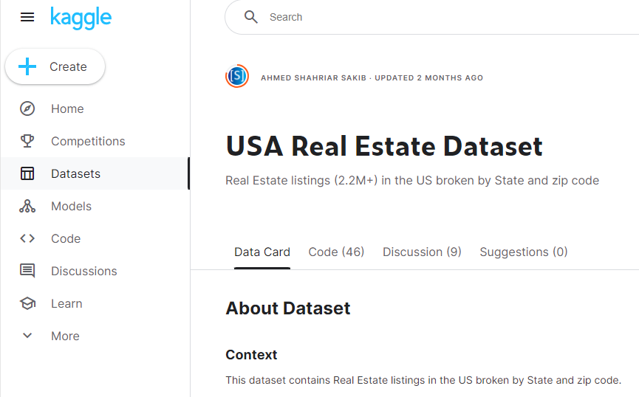
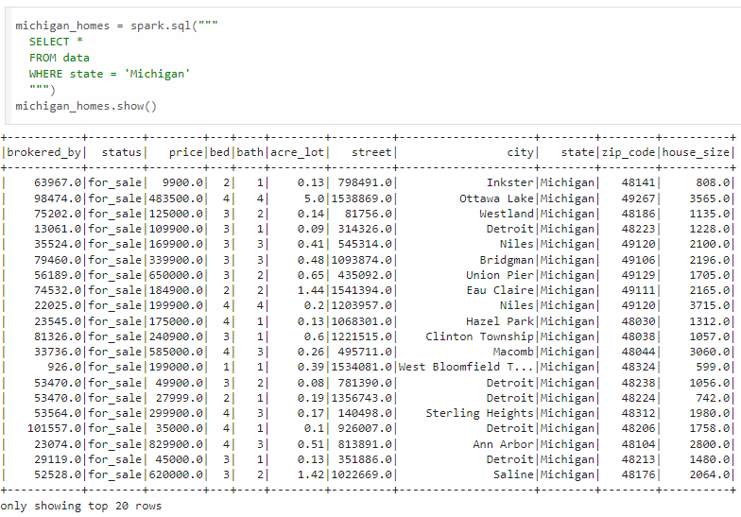

ETL Process

Slide 6

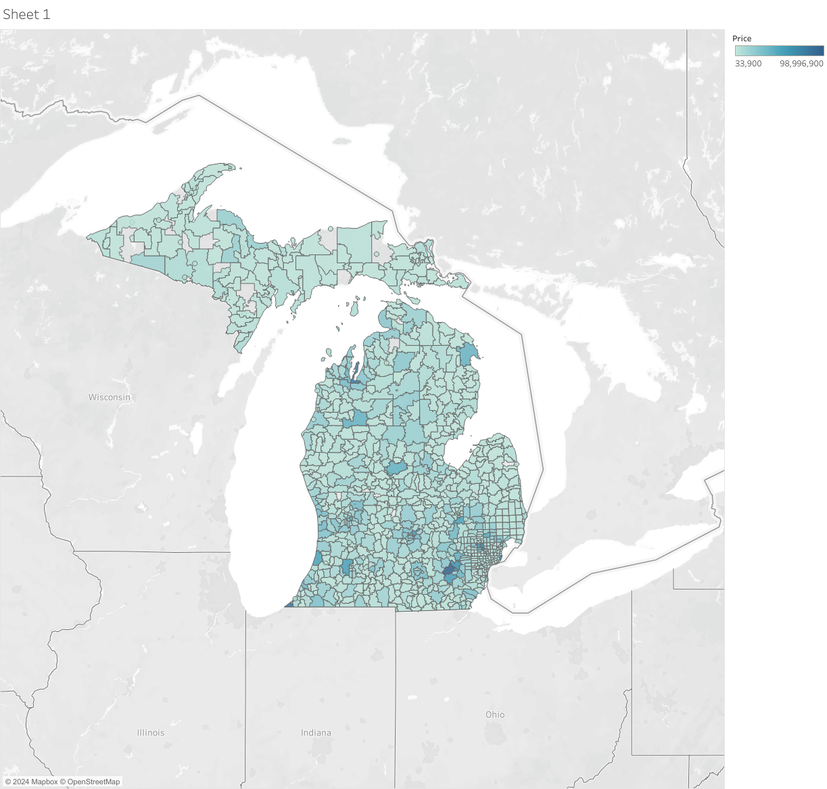
VISUALIZATION
Darker green = higher price
Grey counties = no data
Highest prices seen in the Ann Arbor area

Slide 7
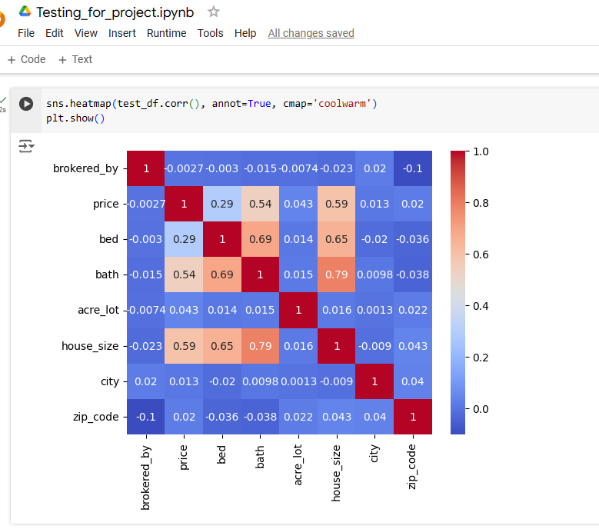
This code shows us the correlation between all variables in the data
Correlation Heatmap
Gives us an idea of what variables will be the most successful in models
You expect high correlation between size and bed/bath

Slide 8
Models
LINEAR REGRESSION
We used a linear regression model to predict price with zip code, bed, bath, acreage, and house size.
DECISION TREE
With sklearn, used beds, baths, acreage, square footage, and zip code as features and price as target.
NEURAL NETWORK
Tried a couple of different versions.
Model used beds, baths, and house size to predict price.
RANDOM FOREST
Using Pyspark, predicted price with beds, baths, acreage, zip code, square footage, and broker.

Slide 9
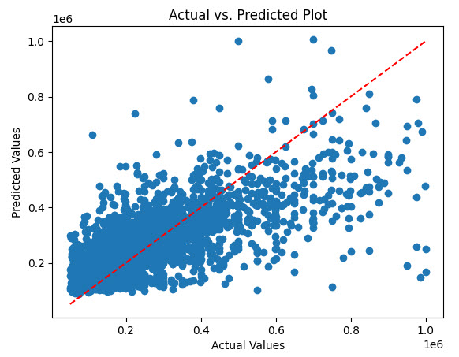
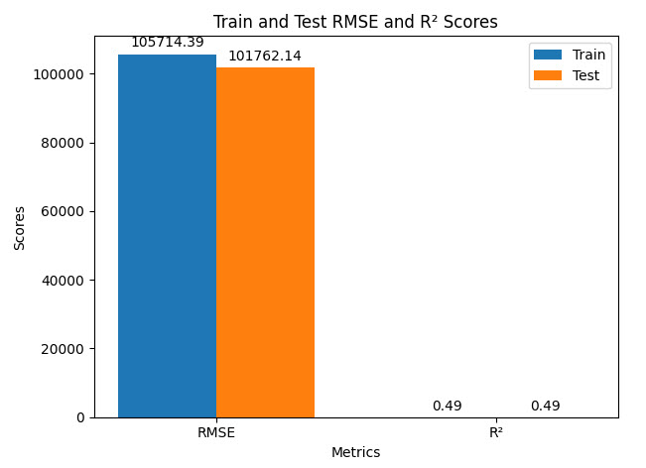
LINEAR REGRESSION MODEL
Notes:
Sklearn, pandas, colab

Slide 10
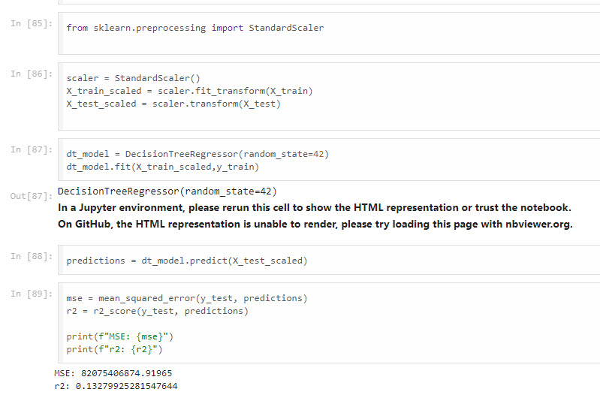
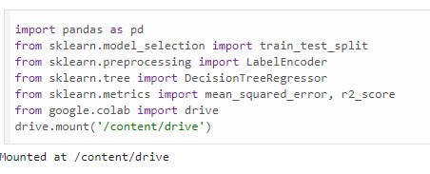
DECISION TREE MODEL

Slide 11
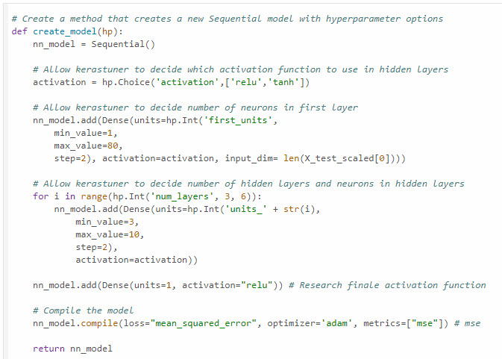
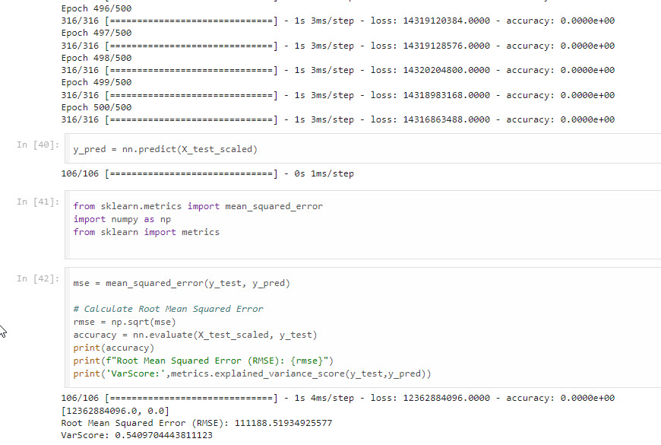
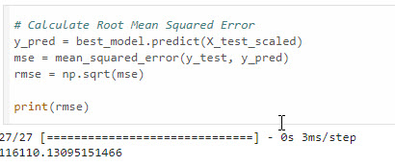
NEURAL NETWORK MODEL
Version 1
Version 2

Slide 12
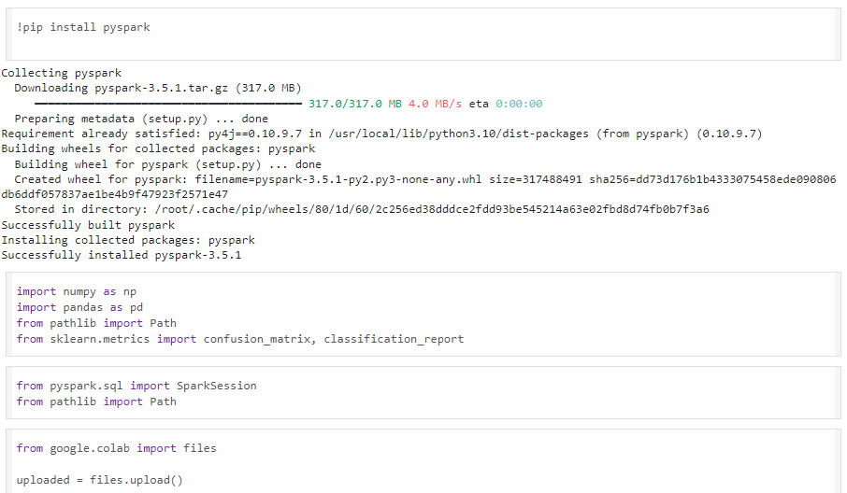
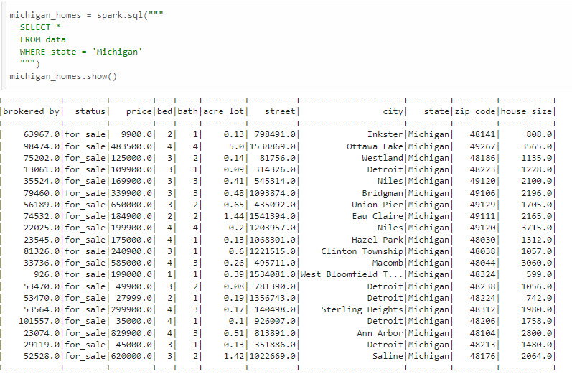
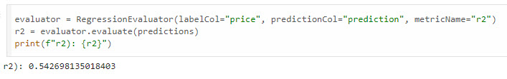
RANDOM FOREST MODEL

Slide 13
The best model that we used was the neural network.
The best model
We used multiple iterations and did our best to optimize each model.
This model was the best because it produced the best root mean square error.

Slide 14




PROJECT CONCLUSIONS
BEST MODEL
We ran several types of models, optimizing and running multiple iterations, and the neural network approach was the best.
WHAT WE LEARNED
Trying a variety of approaches, and performing optimization operations, let us find the best way to utilize the given data.
We now have more tools at our disposal!
OTHER CONSIDERATIONS
Could have tried a time series model
Could have used more data – national?
01
02
03

Slide 15
Thank You

